Slide 1
Relationship between topographic parameters and BRDF for tungsten and beryllium surfaces in the visible spectrum 44th ITPA Diagnostics Topical Group Meeting 7/11/2023
Laurent Marot¹, Mickaël Le Bohec², Hiroki Natsume³, Roland Steiner¹, Shin Kajita⁴, Marie-Hélène Aumeunier²
¹Department of Physics, University of Basel, 4056 Basel, Switzerland
²CEA/IRFM Cadarache, 13108 Saint Paul-Lez-Durance, France
³Graduate School of Engineering, Nagoya University, Nagoya 464-8603, Japan
⁴Graduate School of Frontier Sciences, The University of Tokyo, Kashiwa 277-8561, Japan
laurent.marot@unibas.ch

Slide 2
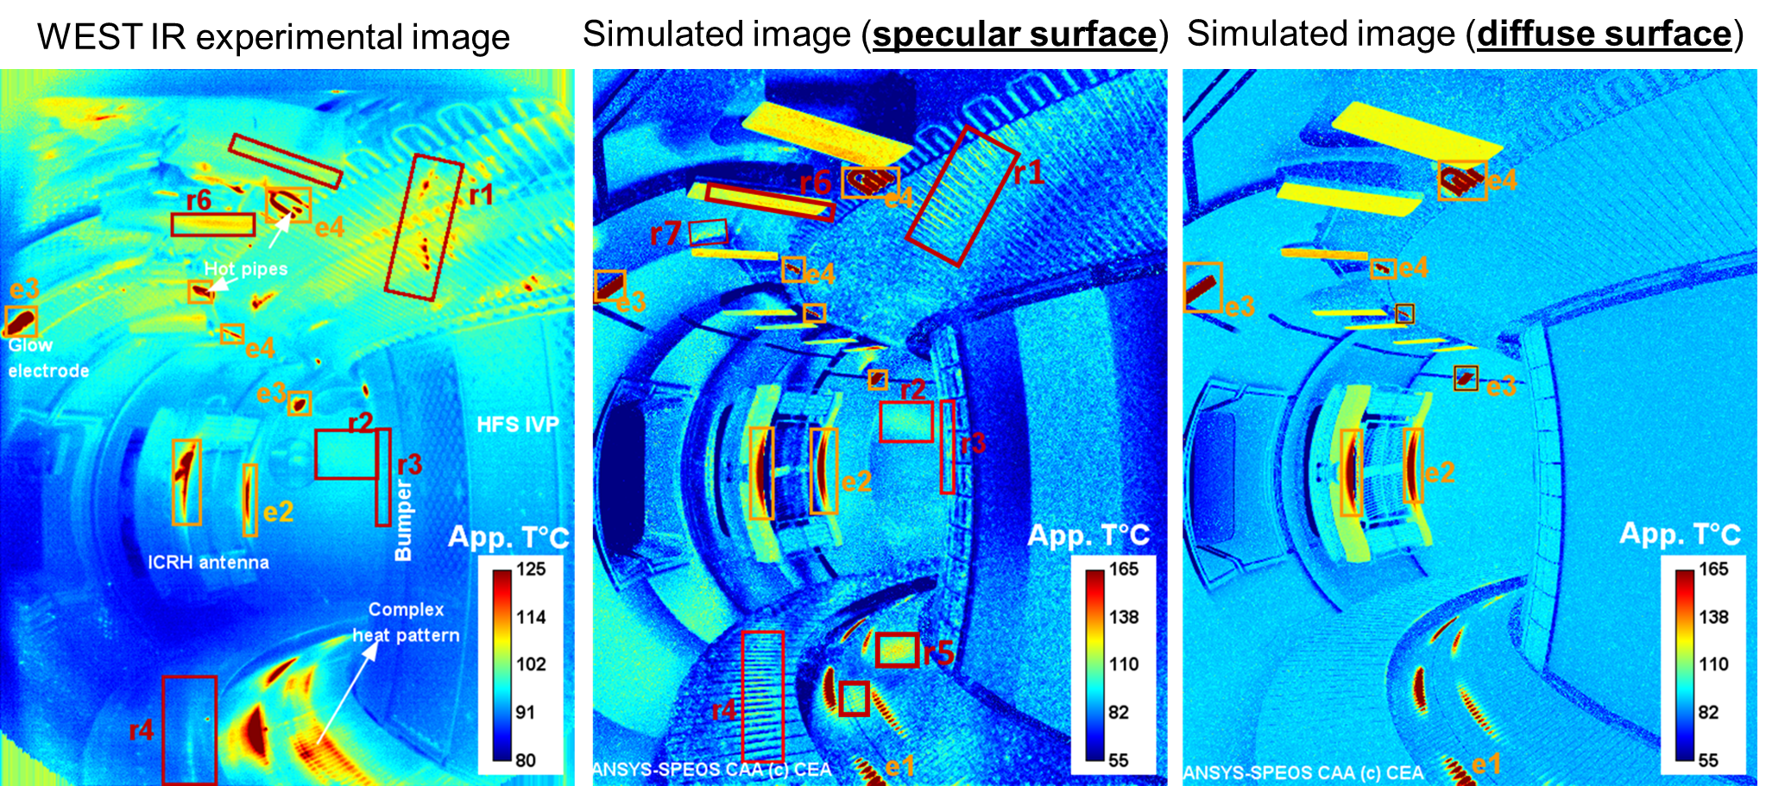
Motivation
The characterization of surface material properties of in-vessel components in fusion devices is needed to understand photon behavior in fully metallic environment and interpret optical images
False hot spot can appear in infrared image according to reflectivity model of materials, considering specular or diffuse surface
Bidirectional Reflectance Distribution Function (BRDF) requires specific laboratory devices to measure spectral and angular-dependence of reflectivity
Characterizing the optical surface properties (emissivity and reflectance) by topography measurements would be more straightforward than BRDF measurement and will help to predict reflections patterns more reliably
R: False hot spot
Aumeunier M-H. et al., Nuclear Materials and Energy 26 (2021) 100879 https://doi.org/10.1016/j.nme.2020.100879

Slide 3
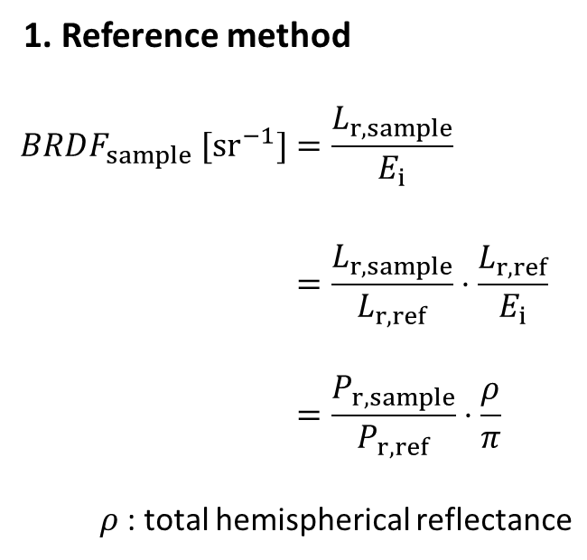
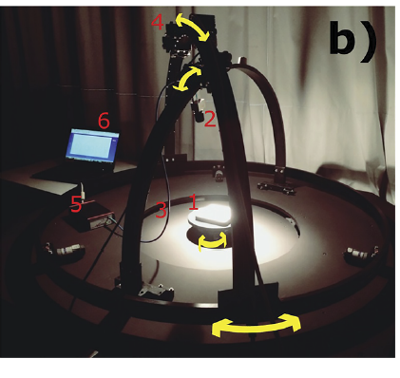
BRDF measurements setups
BULGO: Basel University Laboratory Goniometer
Ben Yaala, M., et al. "Bidirectional reflectance measurement of tungsten samples to assess reflection model in WEST tokamak." Review of Scientific Instruments 92.9 (2021)
https://doi.org/10.1063/5.0046140

Slide 4
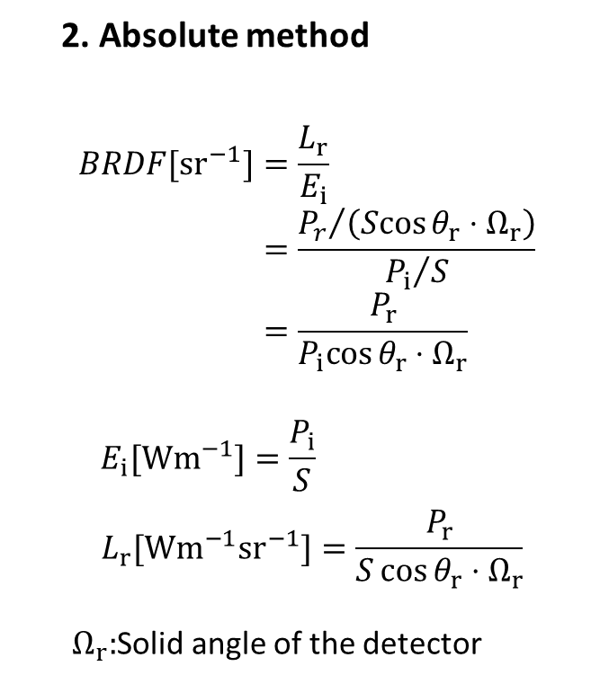
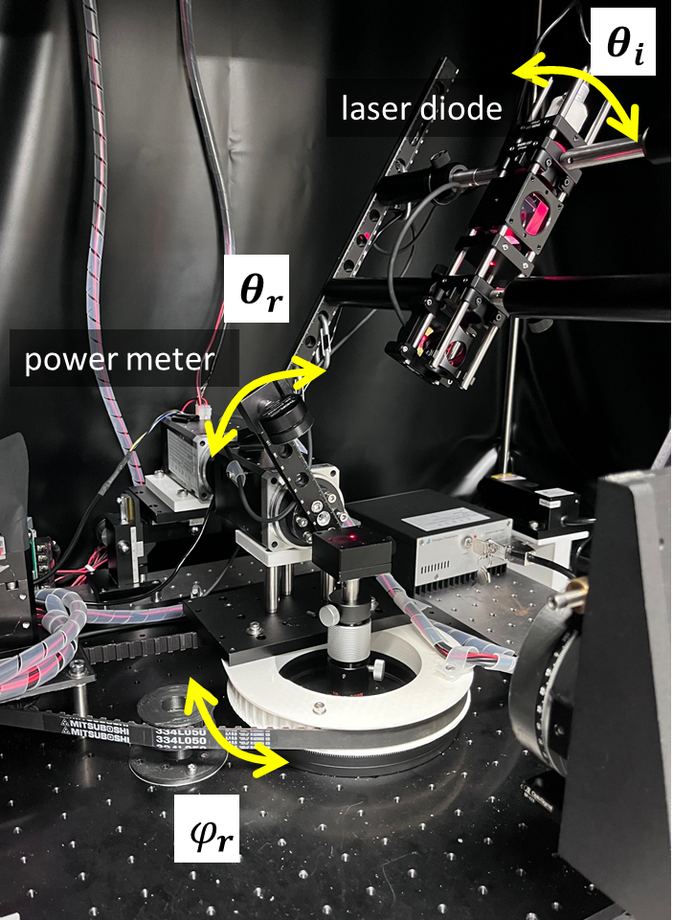
BRDF measurements setups
BULGO: Basel University Laboratory Goniometer
NAGO: Nagoya Goniophotometer
Ben Yaala, M., et al. "Bidirectional reflectance measurement of tungsten samples to assess reflection model in WEST tokamak." Review of Scientific Instruments 92.9 (2021)
https://doi.org/10.1063/5.0046140

Slide 5
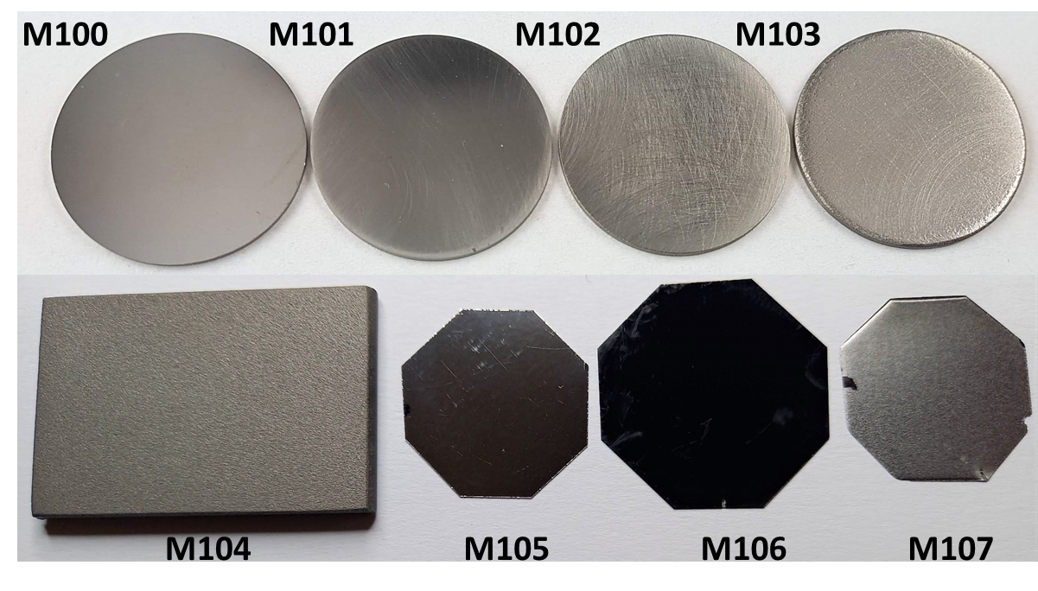
Tungsten samples
Tungsten samples with different topographies M100-M107

Slide 6
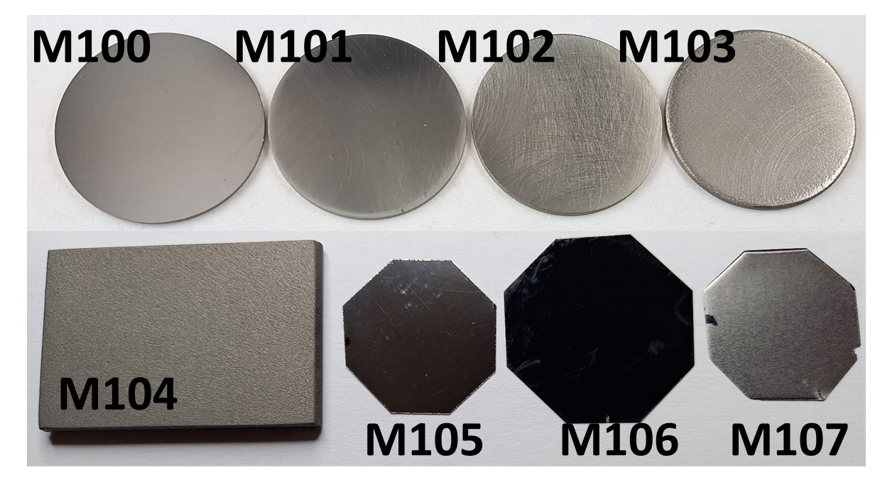
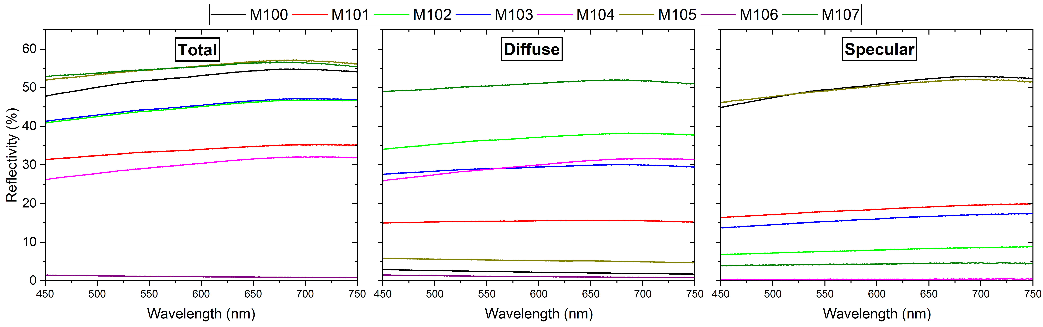
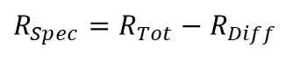
Tungsten samples
M104
M105
M106
M107
$$R_{Spec}=R_{Tot}−R_{Diff}$$

Slide 7
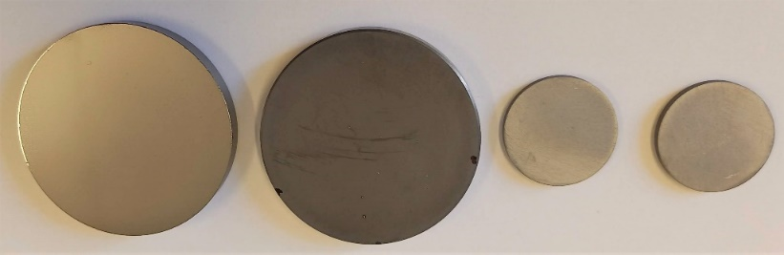
Beryllium samples
Beryllium samples with different topographies M200-M203
M200
M201
M202
M203

Slide 8
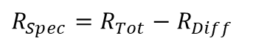
Beryllium samples
Beryllium samples with different topographies M200-M203
M200
M201
M202
M203
$$R_{Spec}=R_{Tot}−R_{Diff}$$

Slide 9
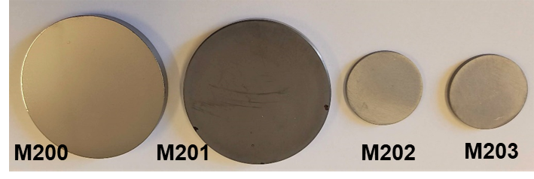
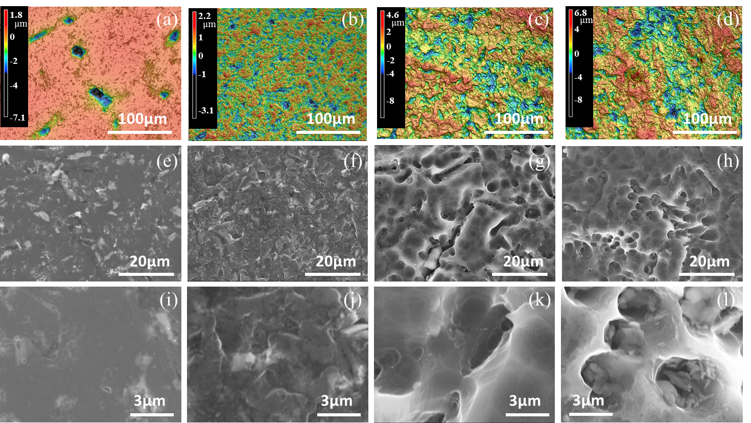
Beryllium samples
M200
Ra 0.27µm
M201
Ra 0.35µm
M202
Ra 1.19µm
M203
Ra 0.98µm
Beryllium samples with different topographies M200-M203

Slide 10
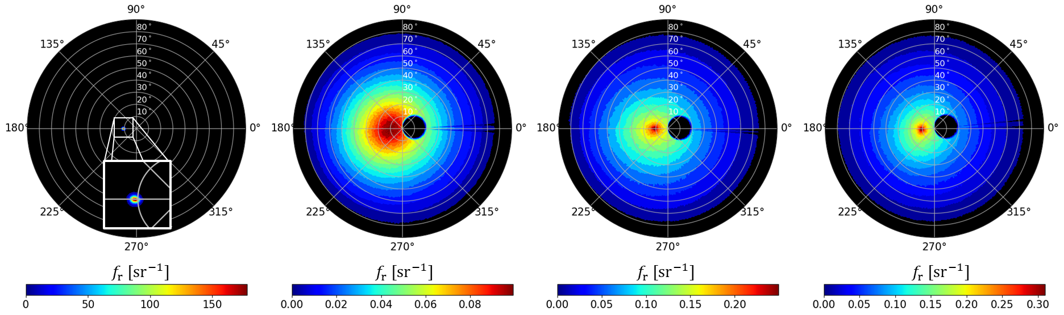
2D BRDF of beryllium samples
2D BRDF of M200-203 at θi = 10◦ plotted in polar coordinates with ϕr ranging from 0 to 360◦ and θr ranging from 0 to 90◦ for convenience measured with NAGO
M200

Slide 11
2D BRDF of beryllium samples
2D BRDF of M200-203 at θi = 10◦ plotted in polar coordinates with ϕr ranging from 0 to 360◦ and θr ranging from 0 to 90◦ for convenience measured with NAGO
M200
M201
M202
M203

Slide 12
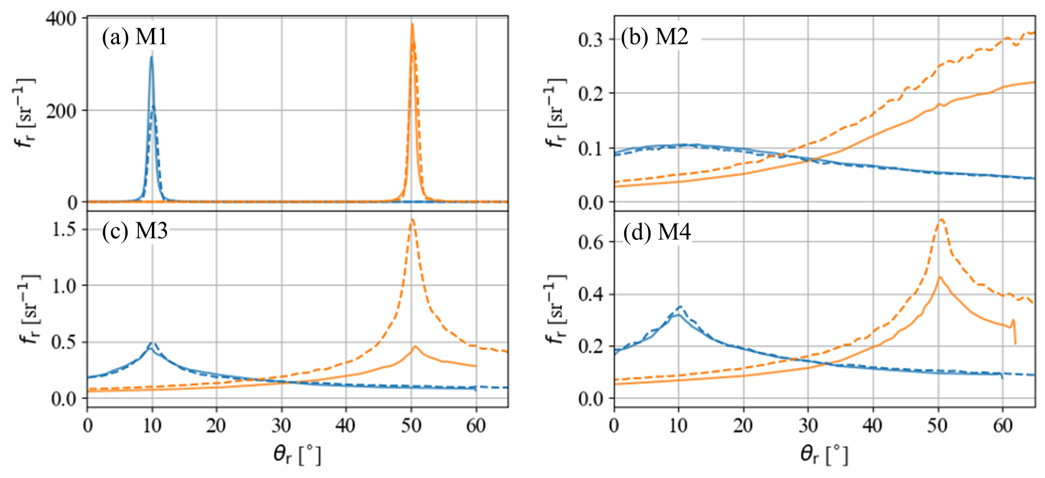
BRDF measurements for BULGO and NAGO
Comparing 1D BRDF for BULGO (solid line) and NAGO (dashed line) at θi = 10◦ (blue) and θi = 50◦ (orange) across (a-d) M200-203
M200
M201
Good agreement between both goniometers
M202
M203

Slide 13
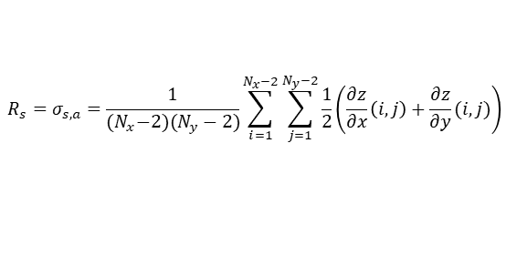
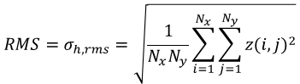
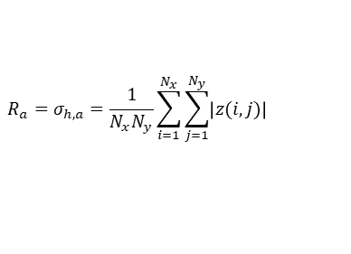
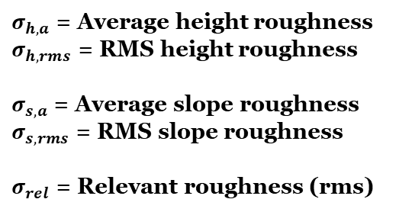
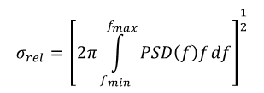
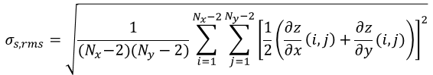
Surface topography
Several formulas:
$${R_{a}=σ}_{h,a}=\frac{1}{N_{x}N_{y}}\sum_{i=1}^{N_{x}}{\sum_{j=1}^{N_{y}}{\left|z(i,j)\right|}}$$
$${RMS=σ}_{h,rms}=\sqrt{\frac{1}{N_{x}N_{y}}\sum_{i=1}^{N_{x}}{\sum_{j=1}^{N_{y}}{{z(i,j)}^{2}}}}$$
$σ_{h,a}$ = Average height roughness
$σ_{h,rms}$ = RMS height roughness
$σ_{s,a}$ = Average slope roughness
$σ_{s,rms}$ = RMS slope roughness
$σ_{rel}$ = Relevant roughness (rms)
$$R_{s}=σ_{s,a}=\frac{1}{{(N}_{x}−2)(N_{y}−2)}\sum_{i=1}^{N_{x}−2}{\sum_{j=1}^{N_{y}−2}{\frac{1}{2}\left(\frac{∂z}{∂x}\left(i,j\right)+\frac{∂z}{∂y}(i,j)\right)}}$$
$$σ_{s,rms}=\sqrt{\frac{1}{{(N}_{x}−2)(N_{y}−2)}\sum_{i=1}^{N_{x}−2}{\sum_{j=1}^{N_{y}−2}{{\left[\frac{1}{2}\left(\frac{∂z}{∂x}\left(i,j\right)+\frac{∂z}{∂y}(i,j)\right)\right]}^{2}}}}$$
$$σ_{rel}={\left[2π\int_{f_{min}}^{f_{max}}{PSD\left(f\right)f}df\right]}^{\frac{1}{2}}$$

Slide 14
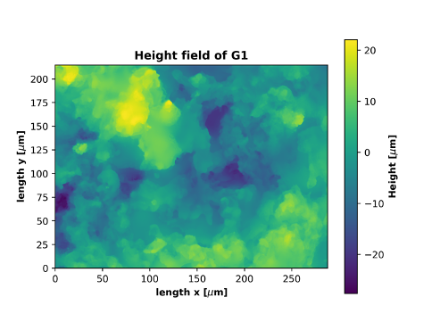
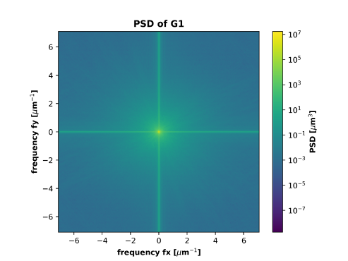
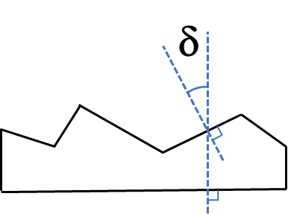
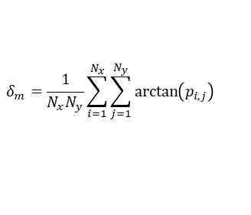
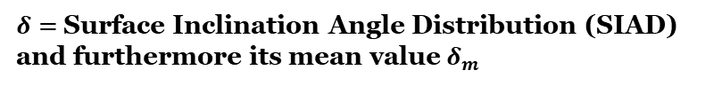
Surface topography
Several formulas:
$${R_{a}=σ}_{h,a}=\frac{1}{N_{x}N_{y}}\sum_{i=1}^{N_{x}}{\sum_{j=1}^{N_{y}}{\left|z(i,j)\right|}}$$
$${RMS=σ}_{h,rms}=\sqrt{\frac{1}{N_{x}N_{y}}\sum_{i=1}^{N_{x}}{\sum_{j=1}^{N_{y}}{{z(i,j)}^{2}}}}$$
$σ_{h,a}$ = Average height roughness
$σ_{h,rms}$ = RMS height roughness
$σ_{s,a}$ = Average slope roughness
$σ_{s,rms}$ = RMS slope roughness
$σ_{rel}$ = Relevant roughness (rms)
$$R_{s}=σ_{s,a}=\frac{1}{{(N}_{x}−2)(N_{y}−2)}\sum_{i=1}^{N_{x}−2}{\sum_{j=1}^{N_{y}−2}{\frac{1}{2}\left(\frac{∂z}{∂x}\left(i,j\right)+\frac{∂z}{∂y}(i,j)\right)}}$$
$$σ_{s,rms}=\sqrt{\frac{1}{{(N}_{x}−2)(N_{y}−2)}\sum_{i=1}^{N_{x}−2}{\sum_{j=1}^{N_{y}−2}{{\left[\frac{1}{2}\left(\frac{∂z}{∂x}\left(i,j\right)+\frac{∂z}{∂y}(i,j)\right)\right]}^{2}}}}$$
$$σ_{rel}={\left[2π\int_{f_{min}}^{f_{max}}{PSD\left(f\right)f}df\right]}^{\frac{1}{2}}$$
Power Spectral Density (PSD) is based on a Fast Fourier transform (FFT) of an image of surface, it is a representation of the amplitude of a surface’s roughness as a function of the spatial frequency of the roughness
$δ=$Surface Inclination Angle Distribution (SIAD) and furthermore its mean value${ δ}_{m}$
$$δ_{m}=\frac{1}{N_{x}N_{y}}\sum_{i=1}^{N_{x}}{\sum_{j=1}^{N_{y}}{\arctan\left(p_{i,j}\right)}}$$

Slide 15
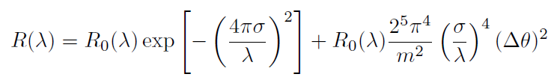
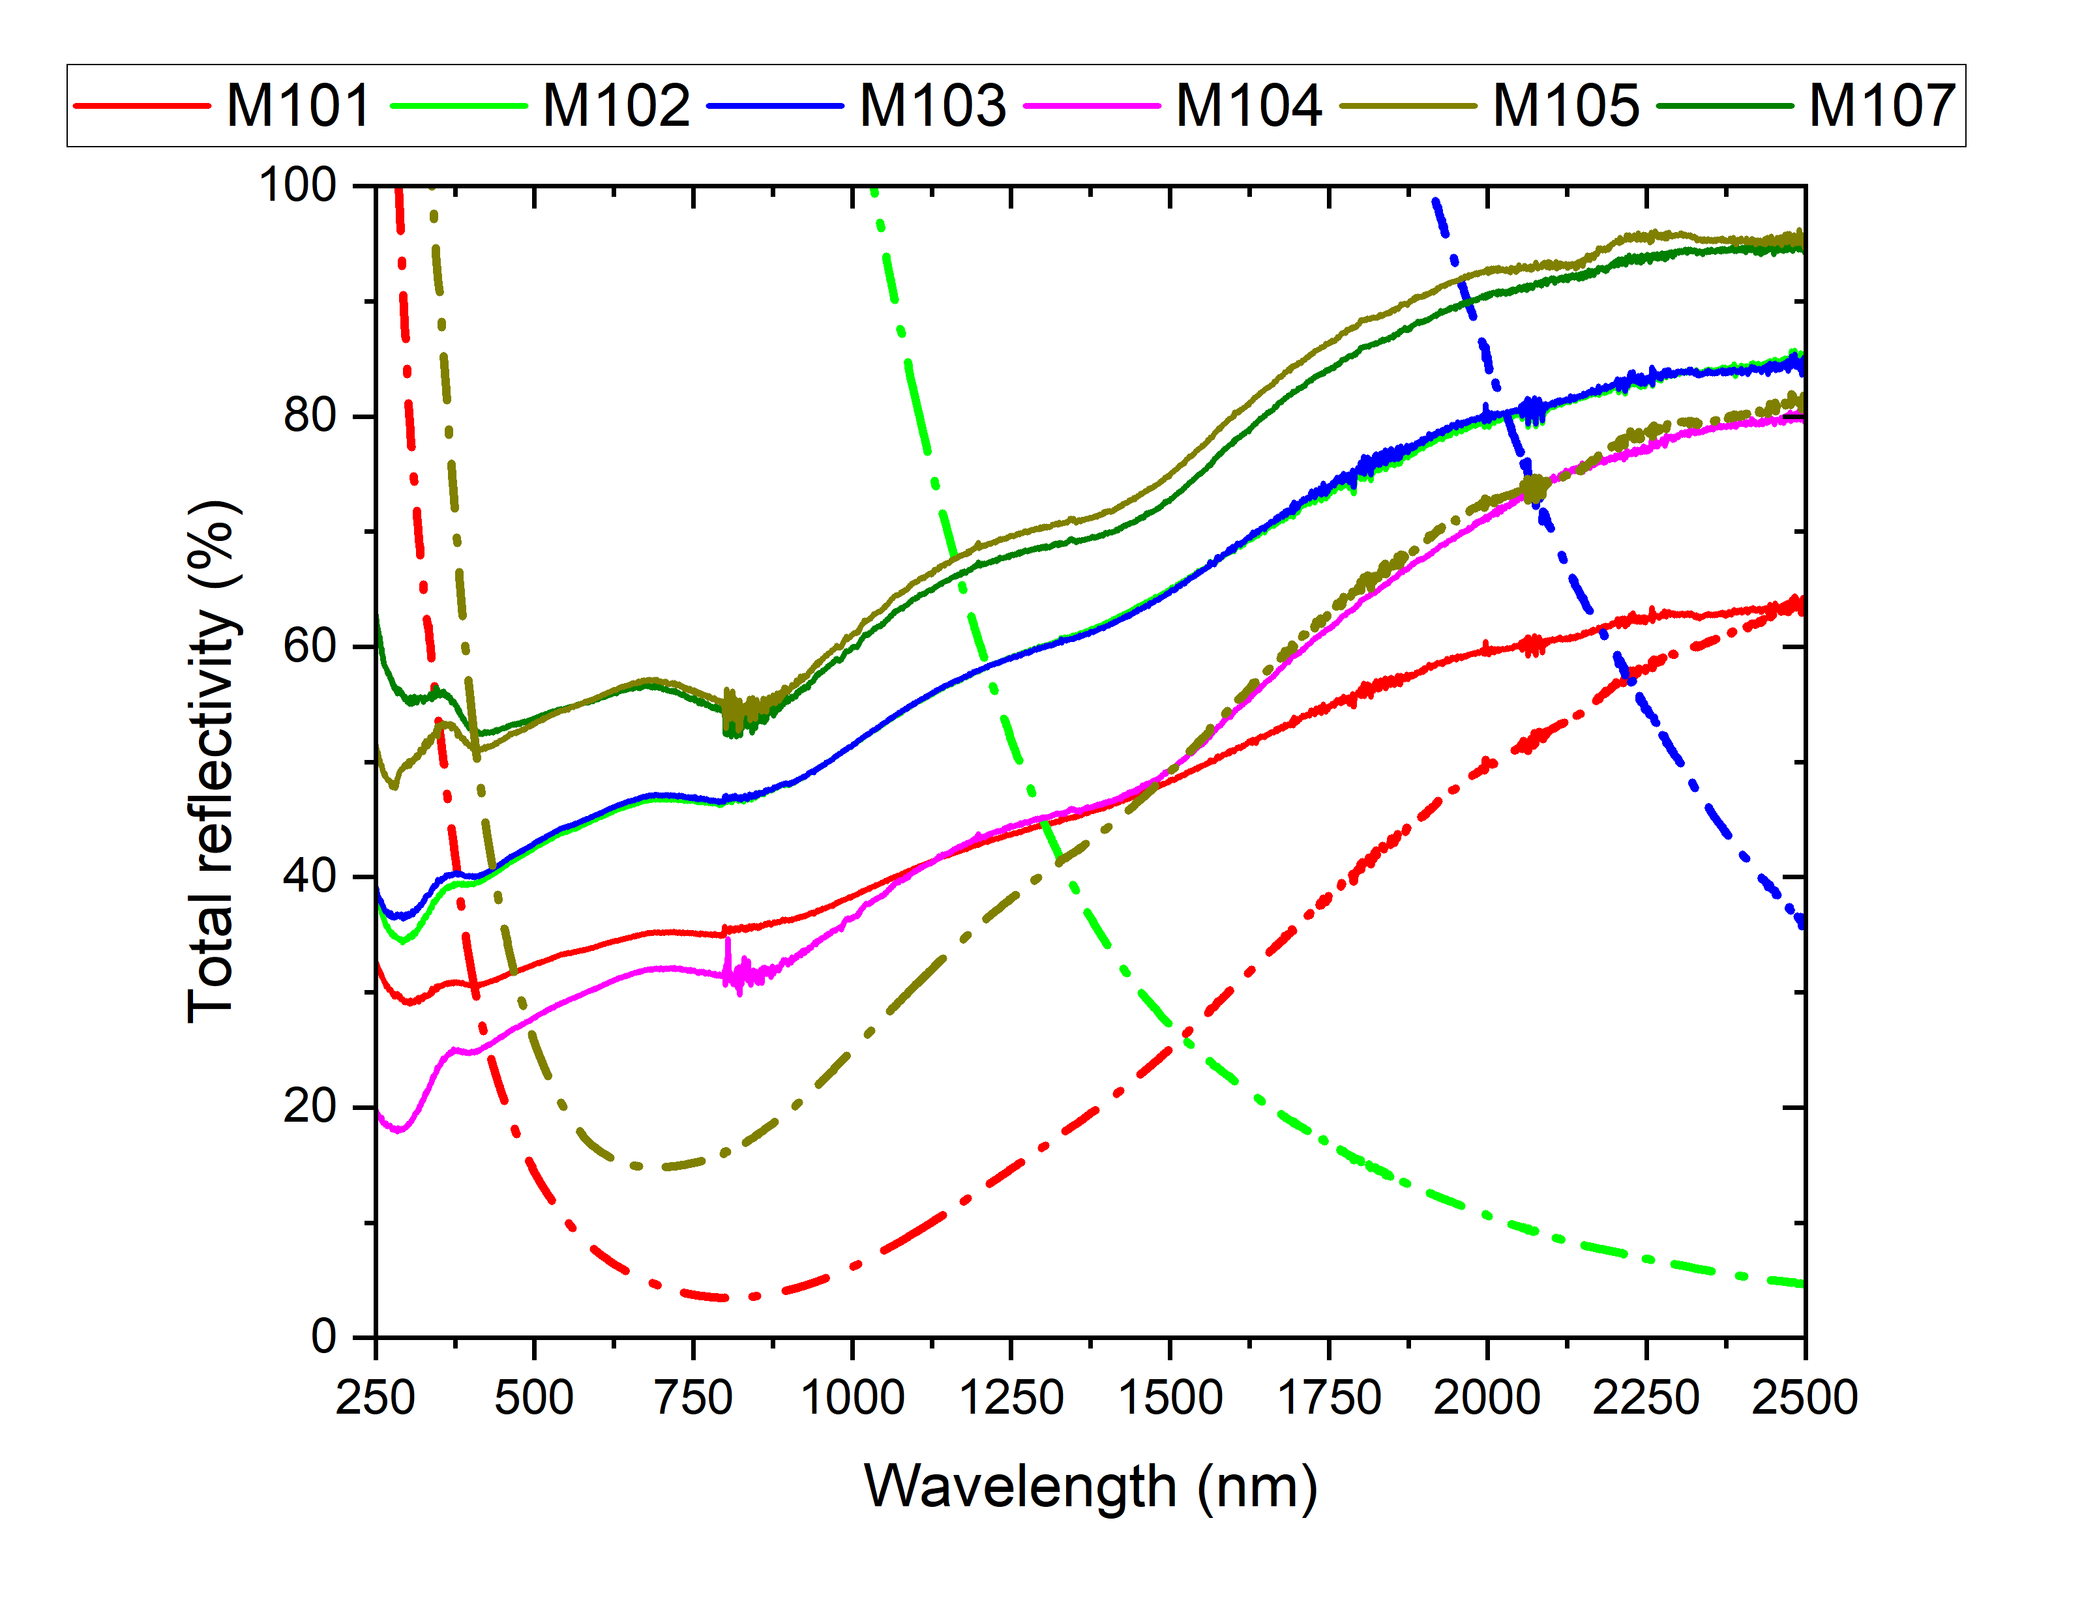
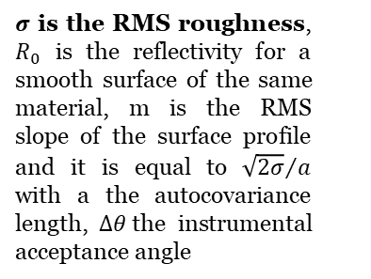
Bennett’s formula and optical properties
Bennett-Porteus law:
M100 used as R0
$σ$ is the RMS roughness, $R_{0}$ is the reflectivity for a smooth surface of the same material, m is the RMS slope of the surface profile and it is equal to ${\sqrt{2σ}}/a$ with a the autocovariance length, $∆θ$the instrumental acceptance angle
Dash line = Bennett-Porteus law
Solid line = measurement
No correlation between Bennett-Porteus law and measurements

Slide 16
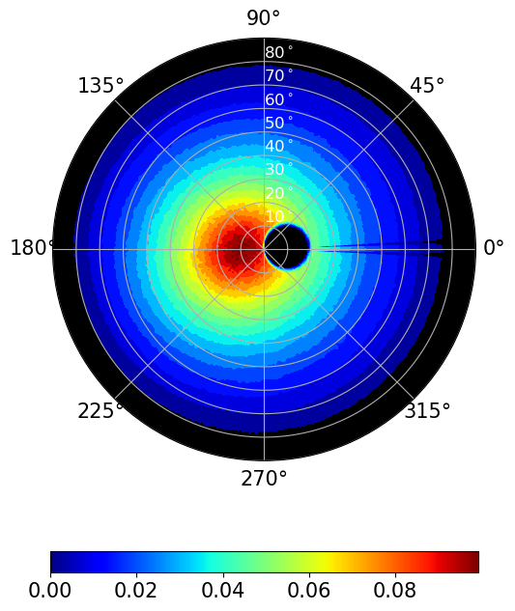
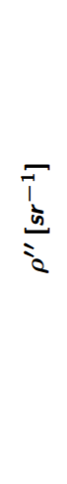
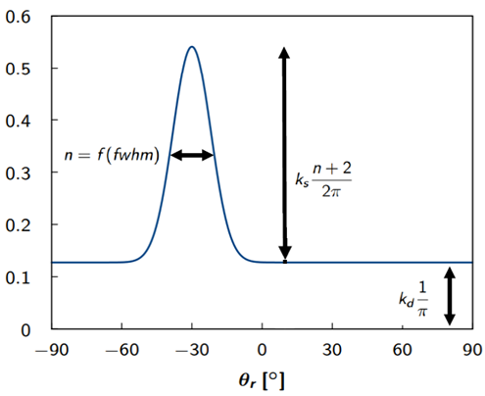
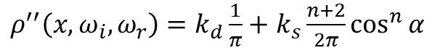
BRDF data and the Phong model
Phong Model:
${ρ^{′′}\left(x,ω_{i},ω_{r}\right)=k}_{d}\frac{1}{π}+$ $k_{s}\frac{n+2}{2π}\cos^{n}{α}$
2D BRDF
1D BRDF fitting

Slide 17
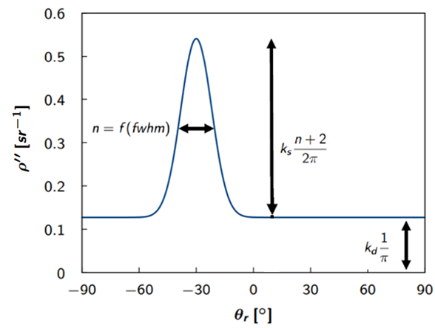
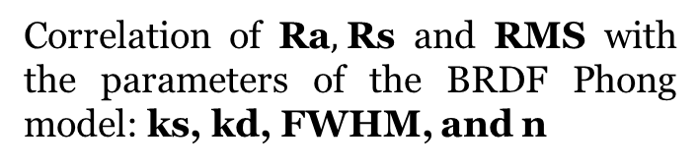
Ra, Rs, RMS correlation with the optical properties
Correlation of Ra$,$Rs and RMS with the parameters of the BRDF Phong model: ks, kd, FWHM, and n
No correlation ( Low R²)

Slide 18
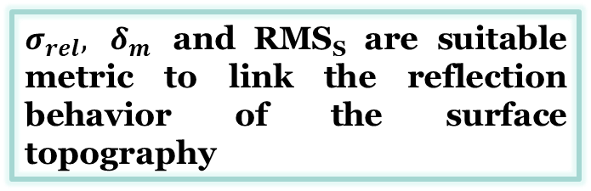
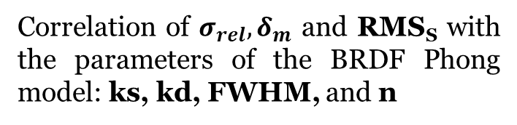
$σ_{rel}, δ_{m}$ and RMS_{S} correlation with the optical properties
Correlation of $σ_{rel}, δ_{m}$ and RMS_{S} with the parameters of the BRDF Phong model: ks, kd, FWHM, and n
$σ_{rel}, δ_{m}$ and RMS_{S} are suitable metric to link the reflection behavior of the surface topography

Slide 19
PSD and diffuse reflectivity correlation
From 2D PSD of 1D
Relatively good correlation between PSD and diffuse reflectivity

Slide 20
Conclusions
For several tungsten and beryllium samples, Ra, which is the usual measure of surface roughness, is not the most suitable metric to link with the reflection behavior of the surface.

Slide 21
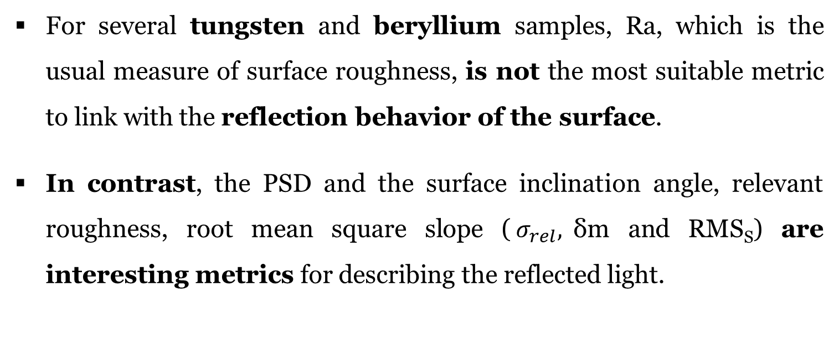
Conclusions
For several tungsten and beryllium samples, Ra, which is the usual measure of surface roughness, is not the most suitable metric to link with the reflection behavior of the surface.
In contrast, the PSD and the surface inclination angle, relevant roughness, root mean square slope ($σ_{rel},$δm and RMS_{S}) are interesting metrics for describing the reflected light.

Slide 22
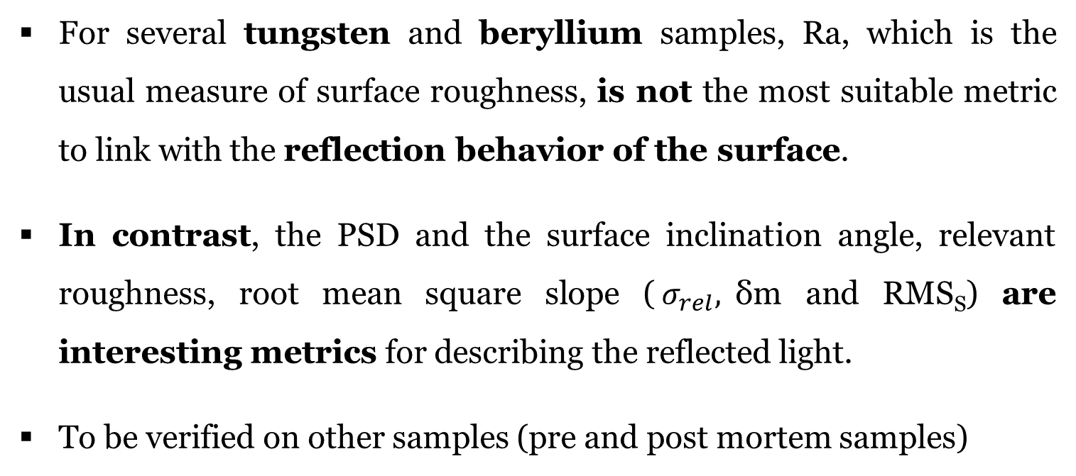
Conclusions
For several tungsten and beryllium samples, Ra, which is the usual measure of surface roughness, is not the most suitable metric to link with the reflection behavior of the surface.
In contrast, the PSD and the surface inclination angle, relevant roughness, root mean square slope ($σ_{rel},$δm and RMS_{S}) are interesting metrics for describing the reflected light.
To be verified on other samples (pre and post mortem samples)

Slide 23
More details
Hiroki Natsume, Mickaël Le Bohec, Roland Steiner, Marwa Ben Yaala, Marie-Hélène Aumeunier, Laurent Marot, Shin Kajita, and Hirohiko Tanaka, Effect of beryllium topography on BRDF measurements, Submitted to Optical Materials
Mickaël Le Bohec, Roland Steiner, Hiroki Natsume, Shin Kajita, Marwa Ben Yaala, Laurent Marot, Marie-Hélène Aumeunier, Relationship between topographic parameters and BRDF for tungsten surfaces in the visible spectrum, Submitted to Optik

Slide 24
Thank you for your attention.

